Slide 1

Project Title
Write less; please more pictures! Remove this box!
Senior Design Project Proposal
Student names
Sonoma State University Department of Engineering Science
Advisor: name
Client: name
Date
yourwebpage.weebly.com
youremail@gmail.com

Slide 2

Overview
Problem Statement, Value Proposition, Existing and Proposed Solution
Marketing and Engineering Requirements
System Overview
Challenges and Risks
Tests and Results
Budget and Materials
Schedule
Supporting Courses

Slide 3
Problem Statement
who experiences the problem the most: <WHO>
how do they experience the problem: <WHAT>
the nature of the pain they experience: <WHY>
Eg.
The problem we are exploring addresses seniors 65 years or older who desire to live independently and own smartphones. They are trying to use their phone to communicate real-time with their loved ones. They feel extremely frustrated by their lack of ability to use their phone effectively and shame for letting their loved ones down.
Attention:
Throughout this document
All your FONTS must be consistent!
Pay attention to your splng and grmr!

Slide 4
Value Proposition
Our _____ (Product) helps _______ (Customer) who want to ______ (Jobs to be done) by _______ (verb (reducing, avoiding, etc) + Customer pain) and _______ (verb (increasing, enabling) + Customer gain) unlike (optional) _____________________ (Competing value proposition)

Slide 5
Existing Solutions
What are the existing solutions?

Slide 6
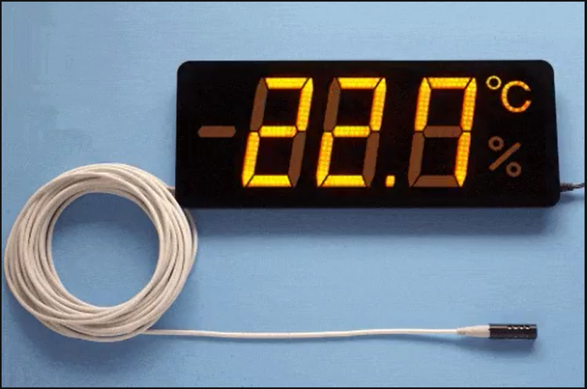
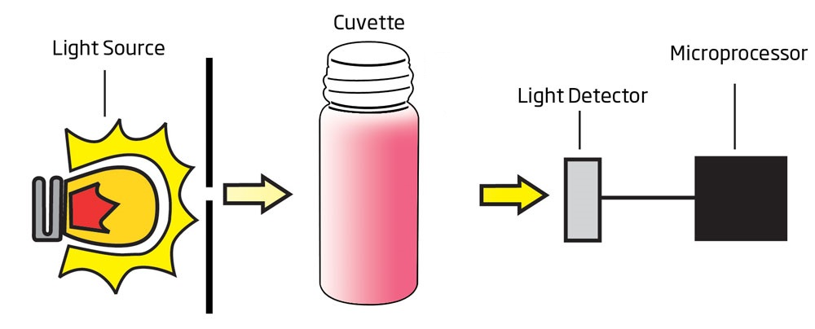
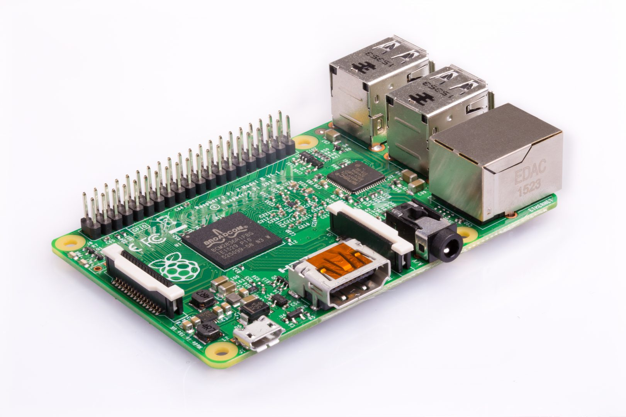
Basic Implementation Of your System
VERY high-level block diagram
Proposed Solution
COLOR DETECTION
BASE STATION
6

Slide 7
Marketing Requirements
Follow the guidelines
Highlight the most important ones
Use “Start at:” under “Bullets and Numbering” to change the starting number

Slide 8
Engineering Requirements
Follow the guidelines
Highlight the most important ones
Continue here

Slide 9
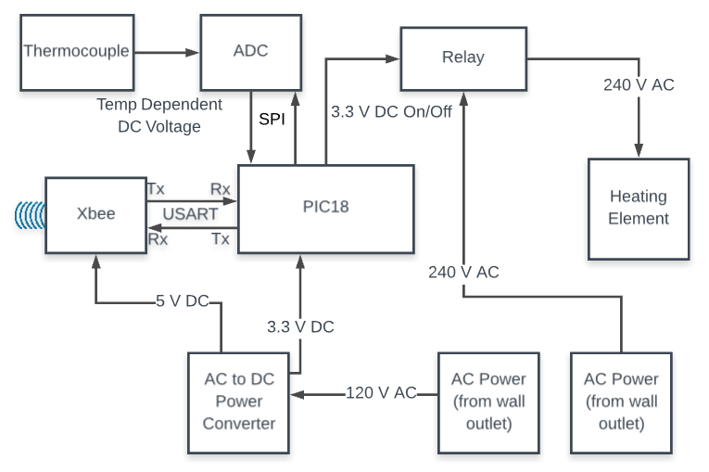
Explain How the system works – Very high-level diagram diagram
System Overview

Slide 10
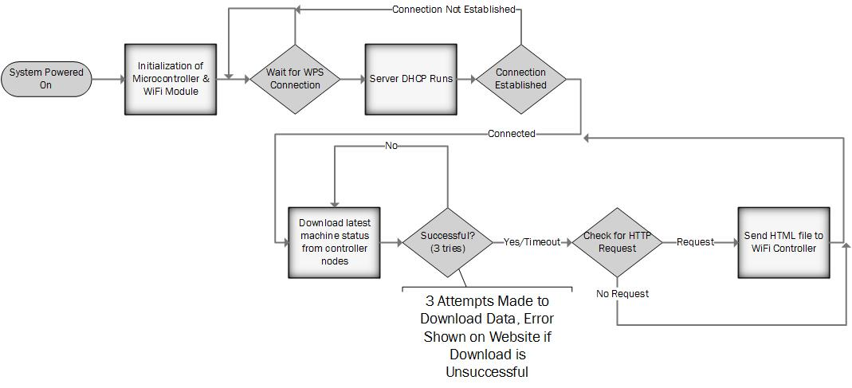
Show flowchart of the software
Software Design

Slide 11
Design Challenges what are your plans if these did not work?
Challenges and Risks

Slide 12
Summery of Tests Conducted
Test Number | Test Objective | Related ER | Status | Notes
FT.1 | Measured power consumption | ER.2 & ER.4 | Completed | Expected 3.2 Wh
FT.2 | Calculate the sampling rate | ER.4 & ER.8 | Completed | Expected sampling rate is 1 MS/s

Slide 13
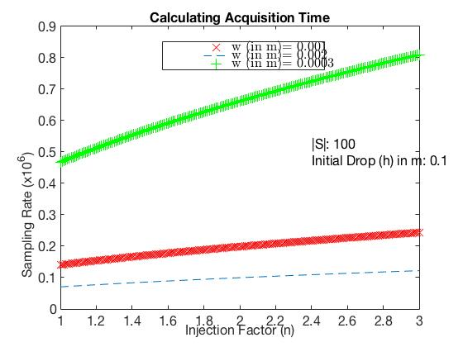
Simple calculation to estimate the minimum sampling rate requirement SR=ΔT/|S| - Using Matlab
Test Results –
Sampling Rate Estimation
Vi=0
h
V’i=Vf
ΔT
w
V’f
n
n.G
G=9.81 m/s^2
Samples Per ΔT:
S={v₁, v₂, v₃, … v_{n}}
|S|=Sample Size =n

Slide 14
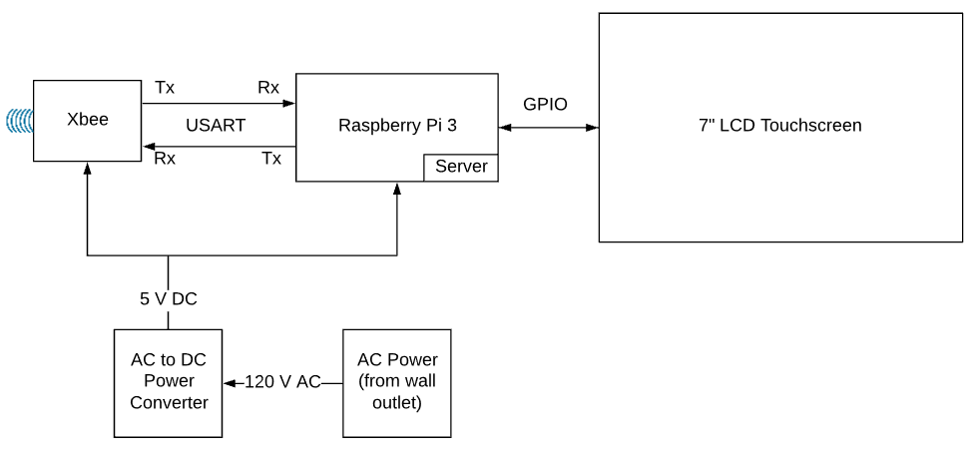
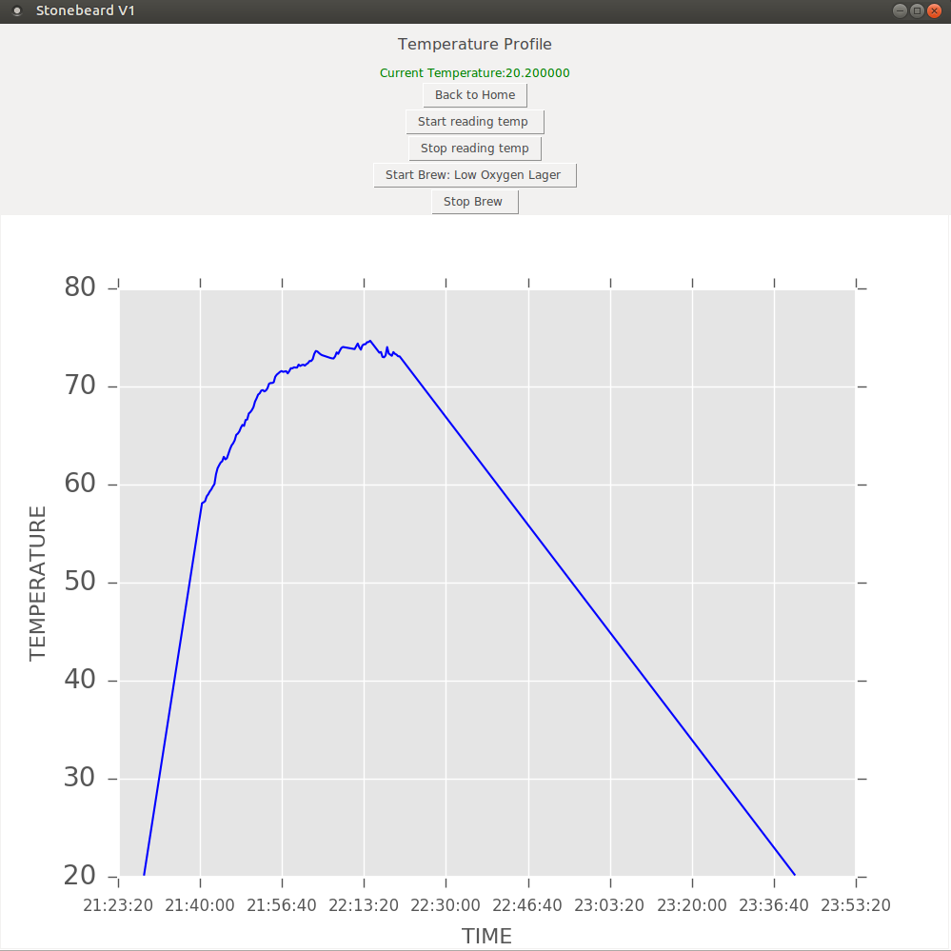
Test Results –
Power Consumption
What have
you tested so far?
EXPLAIN your results!
Results must be readable

Slide 15
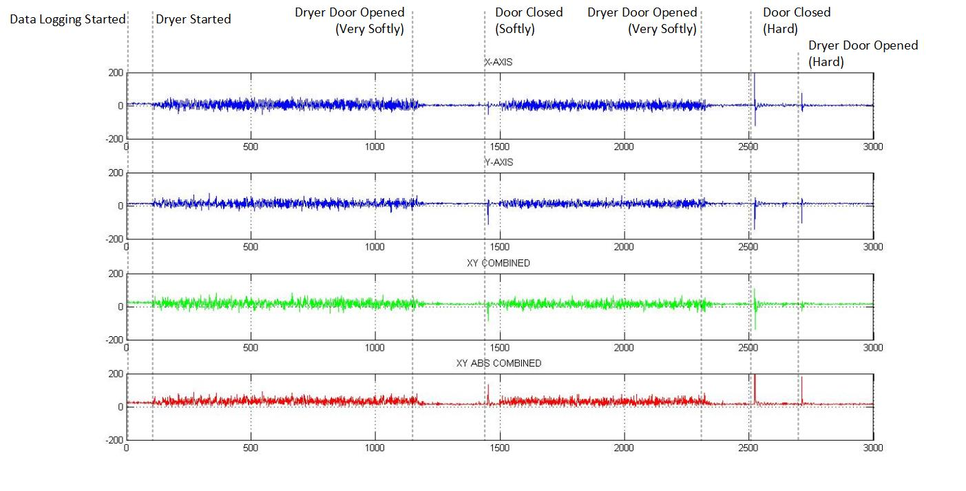
Test Results –
Activity Monitoring
EXPLAIN your results!

Slide 16
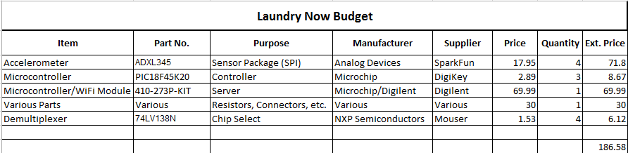
Estimated Budget
Include hardware & software – specify what is already available

Slide 17
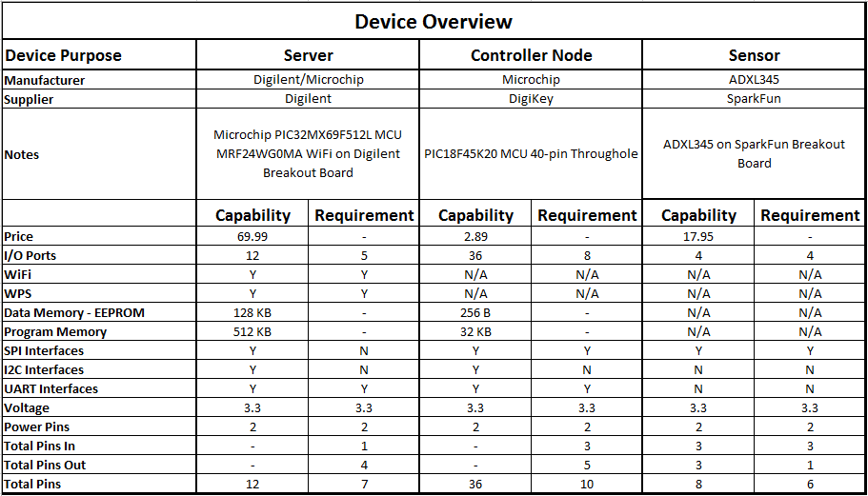
List of Components
Highlight the key component!

Slide 18
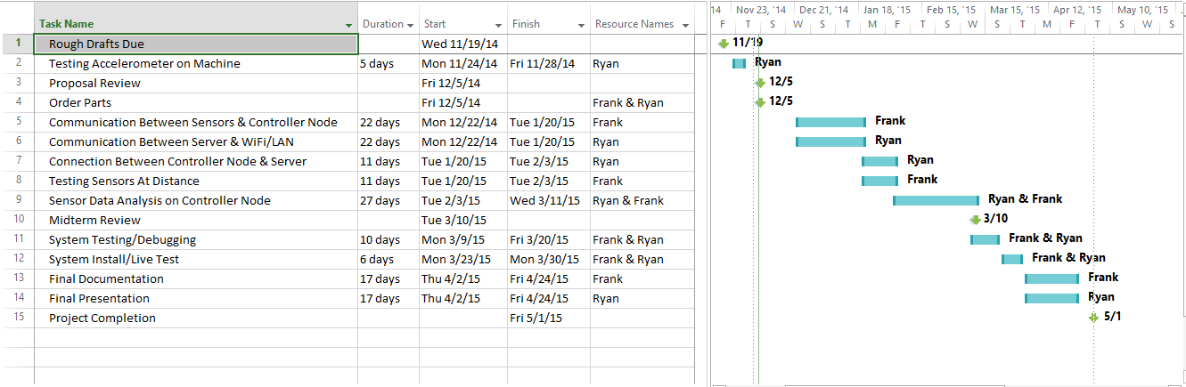
Schedule
Highlight the IMPORTNT DATES

Slide 19
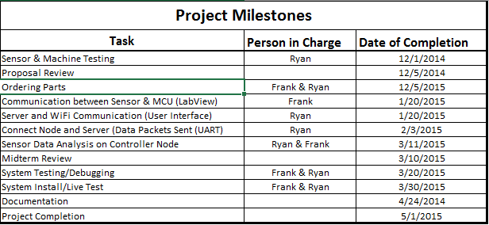
This is what you are committing to complete by January – be specific
Schedule –
Completed by January

Slide 20
Supporting Courses
Electromagnetic Theory and Applications (EE 430)
Introduction to Networking (EE 465)
Robotics (EE 473)

Slide 21
Questions/Comments
Questions

Slide 22
References
IEEE Guide for

